Slide 1
Scrum Events

Slide 2
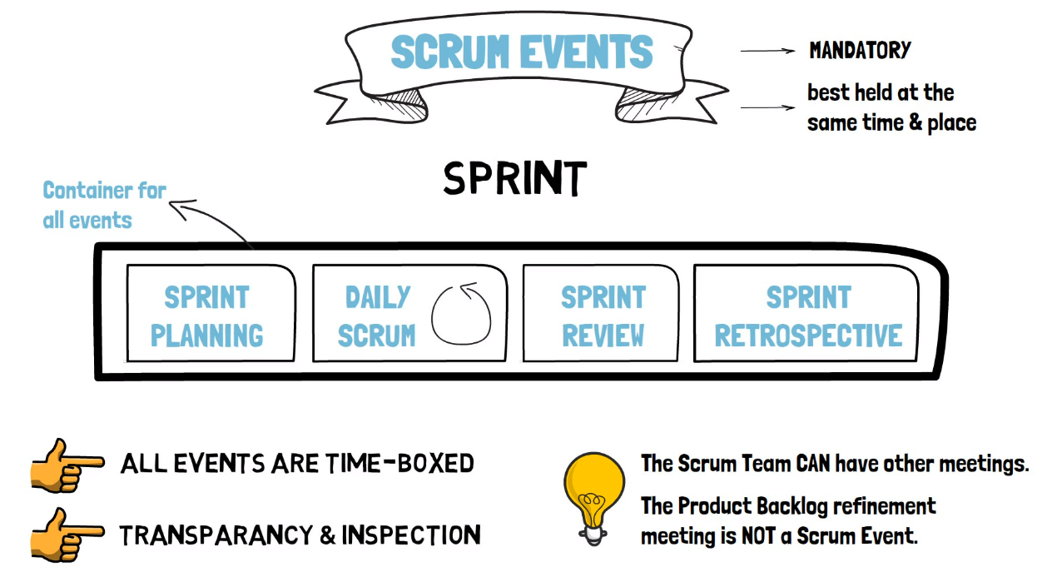

Slide 3
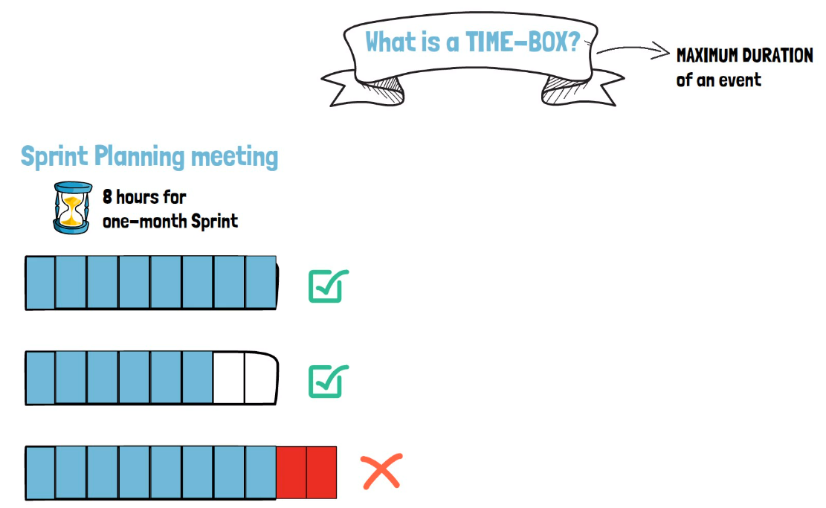
In Scrum, the Time-Box indicates the maximum duration of an event.
Let's take the Sprint planning meeting, for example. This event is Time-Box to eight hours for a one-month Sprint. The Scrum team can use exactly eight hours to plan the Sprint, and this is totally fine.
The Scrum team can reach the purpose of the meeting in only six hours. That is two hours less than the Time-Box and that is fine as well.
What is not allowed is for a meeting to go over the Time-Box

Slide 4
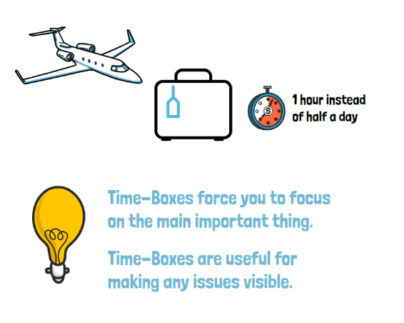
Why are Time-Boxes important?
Let say we have to catch a flight and manage to do our luggage in one hour where we typically need half a day?
Okay, maybe you have forgotten your toothbrush, but you have saved quite a few hours and you can still buy a toothbrush at any store in the airport or at your destination.
This is how Time-Boxes work. They force you to focus on the most important thing.
In this case, catching your flight.

Slide 5
So, To recap
Time-Box indicates the maximum duration of an event, not the minimum duration.
Any scrum event can end before the Time-Box expires if the purpose of the event has been reached.
Under no circumstances is a Scrum event allowed to go over the Time-Box.
Time-Boxes apply to all Scrum events apart from the Sprint itself, which has a fixed duration.
The Sprint is a special case. Even if you finish the work planned before the Sprint ends, the Sprint does not end earlier.

Slide 6
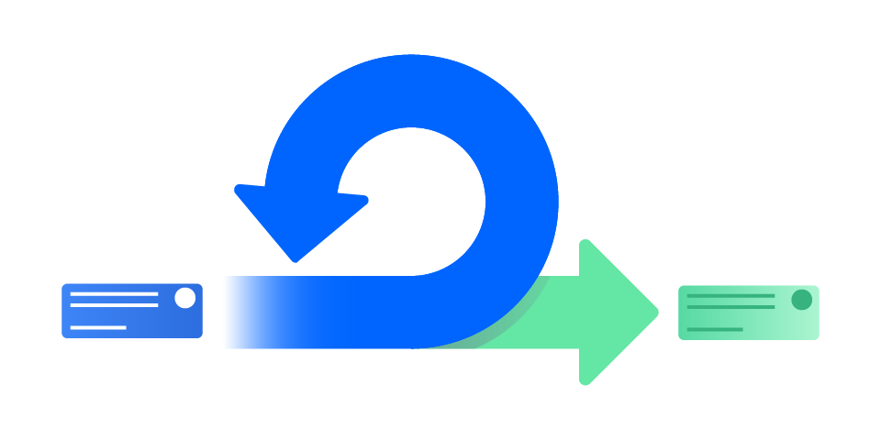
What are sprints?
A sprint is a short, time-boxed period when a scrum team works to complete a set amount of work.
Sprints are at the very heart of scrum and agile methodologies, and getting sprints right will help your agile team ship better software with fewer headaches.
“With scrum, a product is built in a series of iterations called sprints that break down big, complex projects into bite-sized pieces.“
Megan Cook, Group Product Manager for Jira Software at Atlassian.

Slide 7

Sprint
A sprint in Scrum is not like a sprint in sports. It's not about using your entire energy in a short time.
Any development work must happen at a sustainable pace.
Sprint after sprint, working overtime, using up your entire energy and ending up burned out.

Slide 8
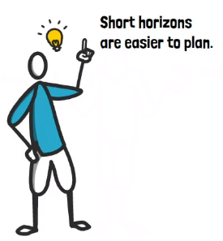
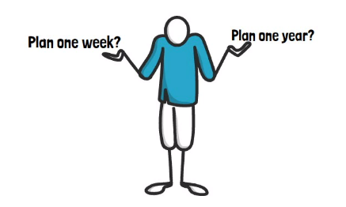
Example
Think about it like this. What is easier?
Of course, plan one week because it’s in short horizon.

Slide 9
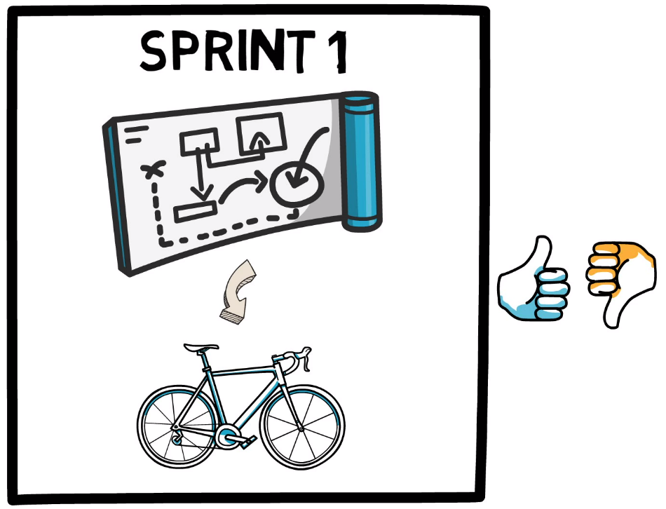
Sprint
The sprint is like a small project that should produce a working product by the end of it, at least after one sprint you know if your idea was good or bad.
Scrum is never about getting everything right from the start. This is impossible in complex environments.

Slide 10
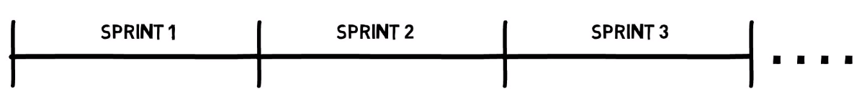
Duration of Sprint
The duration of the sprint will remain the same over multiple sprints. We don't extend the sprint if we feel like we need more time to finish the work.

Slide 11
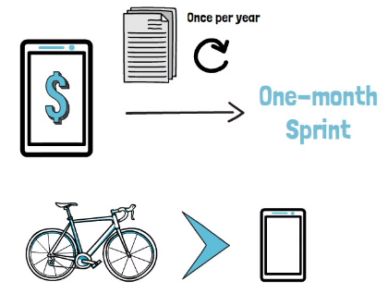
Example
Let say you're working on accounting software; the legislation will typically only change once per year.
So, you can see that the marketplace is rather stable, and requirements are more predictable.
So having a sprint duration of one month may be a good choice.

Slide 12
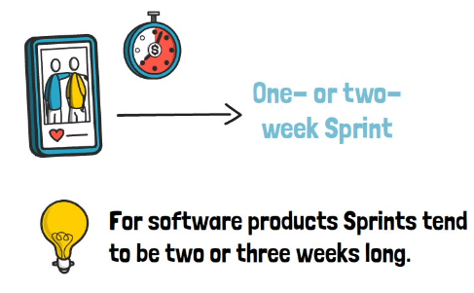
Example
On the Other hand, if you're building the next social media app, you may need to react fast when Instagram or TikTok introduce new features.
So, waiting one month until you can adapt your plan is way long. Probably one- or two-week sprints work best.
The Scrum team in collaboration with the stakeholders and the organization, may decide a sprint duration and align it with internal events, current market conditions, or any other factors deemed relevant.

Slide 13
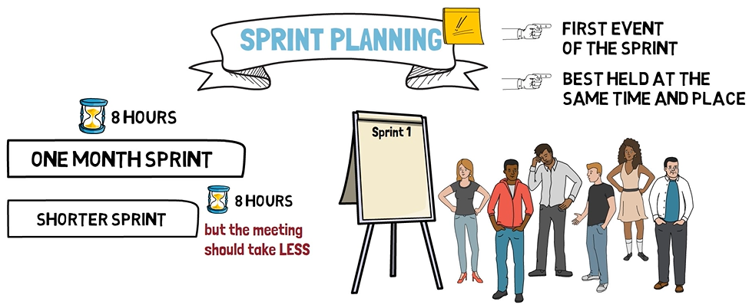
Sprint Planning
Sprint planning is an event in scrum that kicks off the sprint. The purpose of sprint planning is to define what can be delivered in the sprint and how that work will be achieved.
Sprint planning is done in collaboration with the whole scrum team. The sprint planning meeting is time boxed to a maximum of eight hours for a one-month sprint.
For shorter sprints, the event is usually shorter.

Slide 14
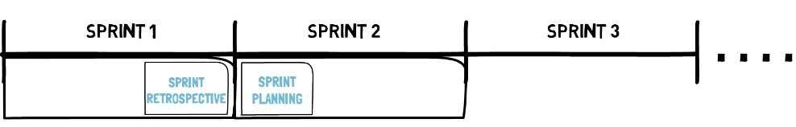
Sprint Planning
Each sprint is like a small project. Instead of planning over a long period, in the sprint planning event the scrum team will only plan a very short period, no more than one month, whatever the sprint duration.
As there are no gaps between sprints, sprint planning happens right after the conclusion of the previous sprint, which is marked by the sprint retrospective.

Slide 15
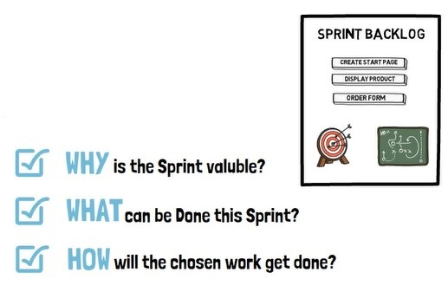
Sprint Planning
The sprint planning event tries to answer the questions of why, what, and how.
Why is the sprint valuable?
What can be done this sprint?
How will the chosen work get done?
The outcome of this meeting is the sprint backlog, which contains the sprint goal, the selected product backlog items that would help achieve the goal and the plan for the sprint.

Slide 16
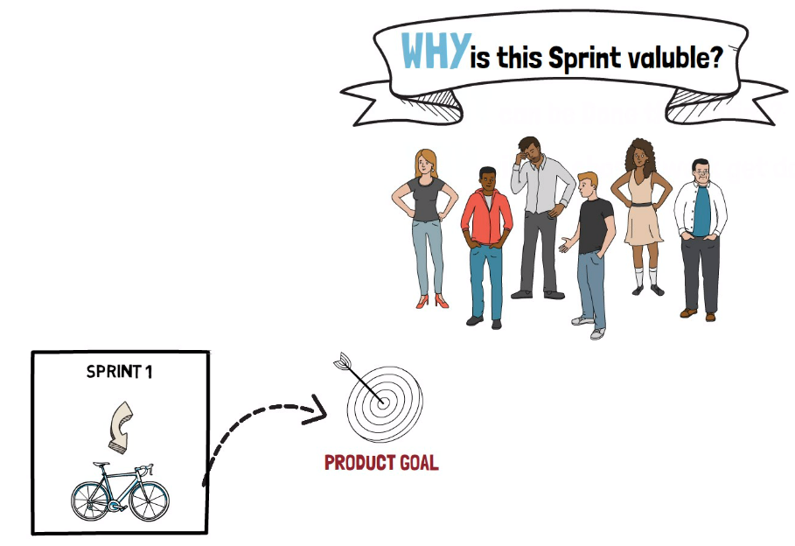
Sprint Planning: Why is this sprint valuable?
This is a question that the scrum team should try to answer.
As each sprint can be seen as an investment and it is expected that the sprint will generate value in some form.
No organization should invest resources to build things just for the sake of it.
So, each sprint should create something valuable and be a step toward reaching the product goal.

Slide 17
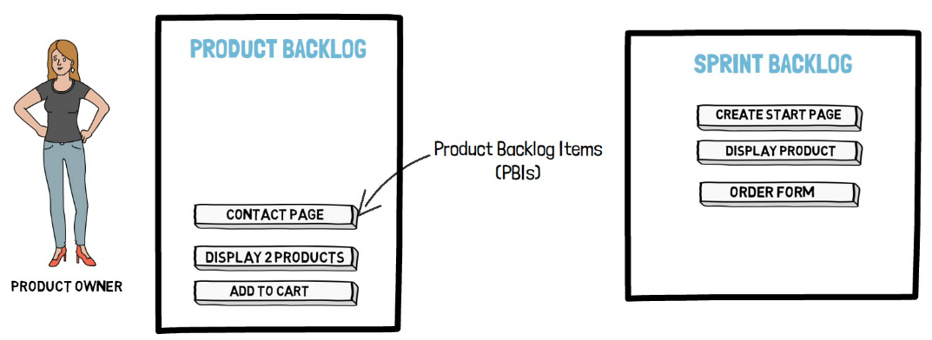
Sprint Planning: Why is this sprint valuable?
The primary tool that the product owner has is the product backlog.
Through the ordering of the PBIs the product owner will decide what will be done next.
So, what is at the top of the product backlog will be implemented in the sprint.

Slide 18
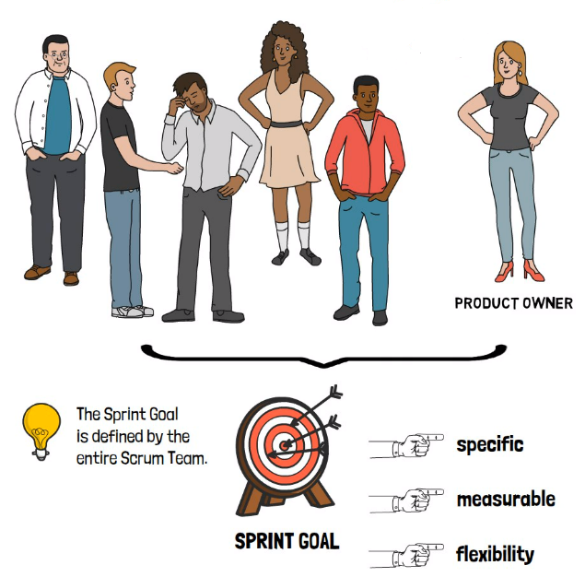
Sprint Planning: Why is this sprint valuable?
The entire scrum team will define a sprint goal which is the objective that the sprint should achieve.
So, the entire scrum team defines the sprint goal, not just the product owner.
It helps if the sprint goal is specific and measurable but leaves some room for flexibility in the implementation.

